Slide 1
Prototypes
Why use a prototype? For client approval and
to have off to the developer

Slide 2
Prototypes – High Fidelity
Prototypes act as a bridge from lo-fi to the actual high-fidelity (hi-fi) interactive final product
Prototypes are important for testing with real users for content flow, and testing for usability, and to spot any flaws.
Prototypes are a polished, detailed, visual design and (a nearly real product) to present and sell to the client for their approval. It is a near representation of how the product will look, and work. And makes it easier for the client to visualize, but costly to produce

Slide 3
Prototypes – High Fidelity (cont’d)
Prototype mockups the almost real looking demo for user testing and client approval
Oliver Lindberg of xd.adobe.com “To sum up its value, the phrase ‘a picture is worth a thousand words’ has been adapted to say ‘a prototype is worth 1,000 meetings,’ or ‘a prototype can paint a 1000 user stories’. Prototyping has become an essential part of the workflow for modern UX and UI designers and, now, it’s one of the most important stages of the product design process.”

Slide 4
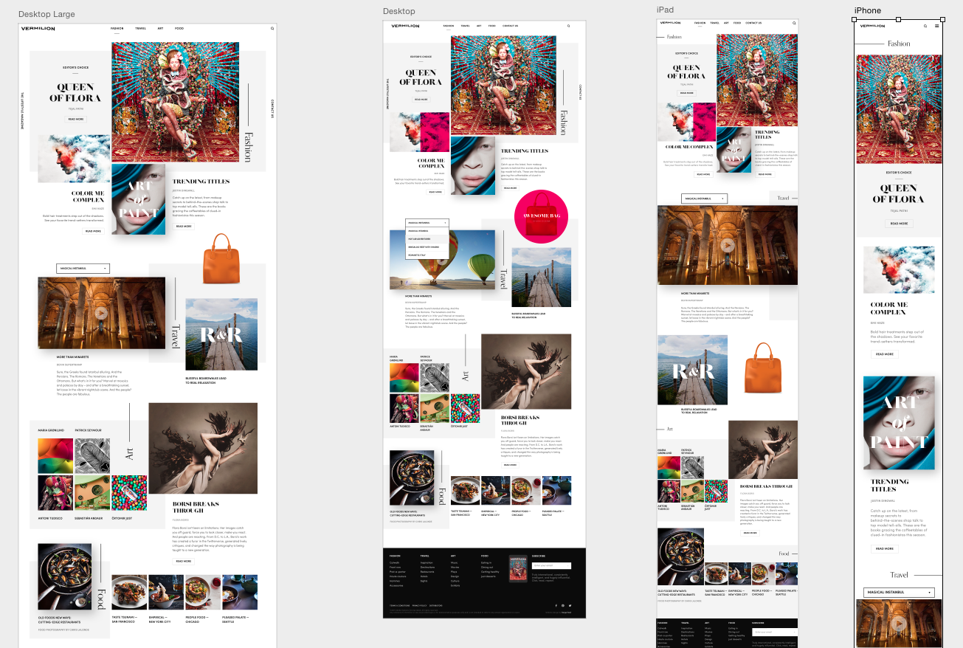
Prototype - High Fidelity (Hi-Fi)
Adobe Photoshop

Slide 5
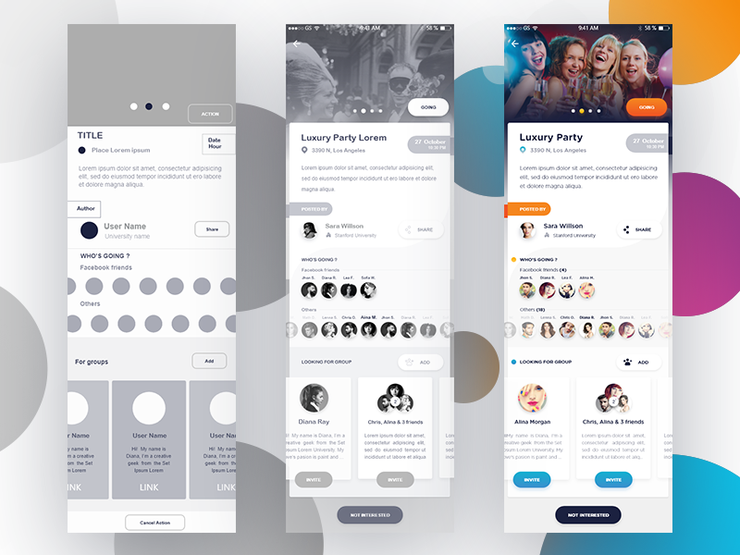
Low, Medium, High Fidelity
REFERENCE

Slide 6
Low, Medium, High Fidelity (cont’d)
REFERENCE

